Slide 1
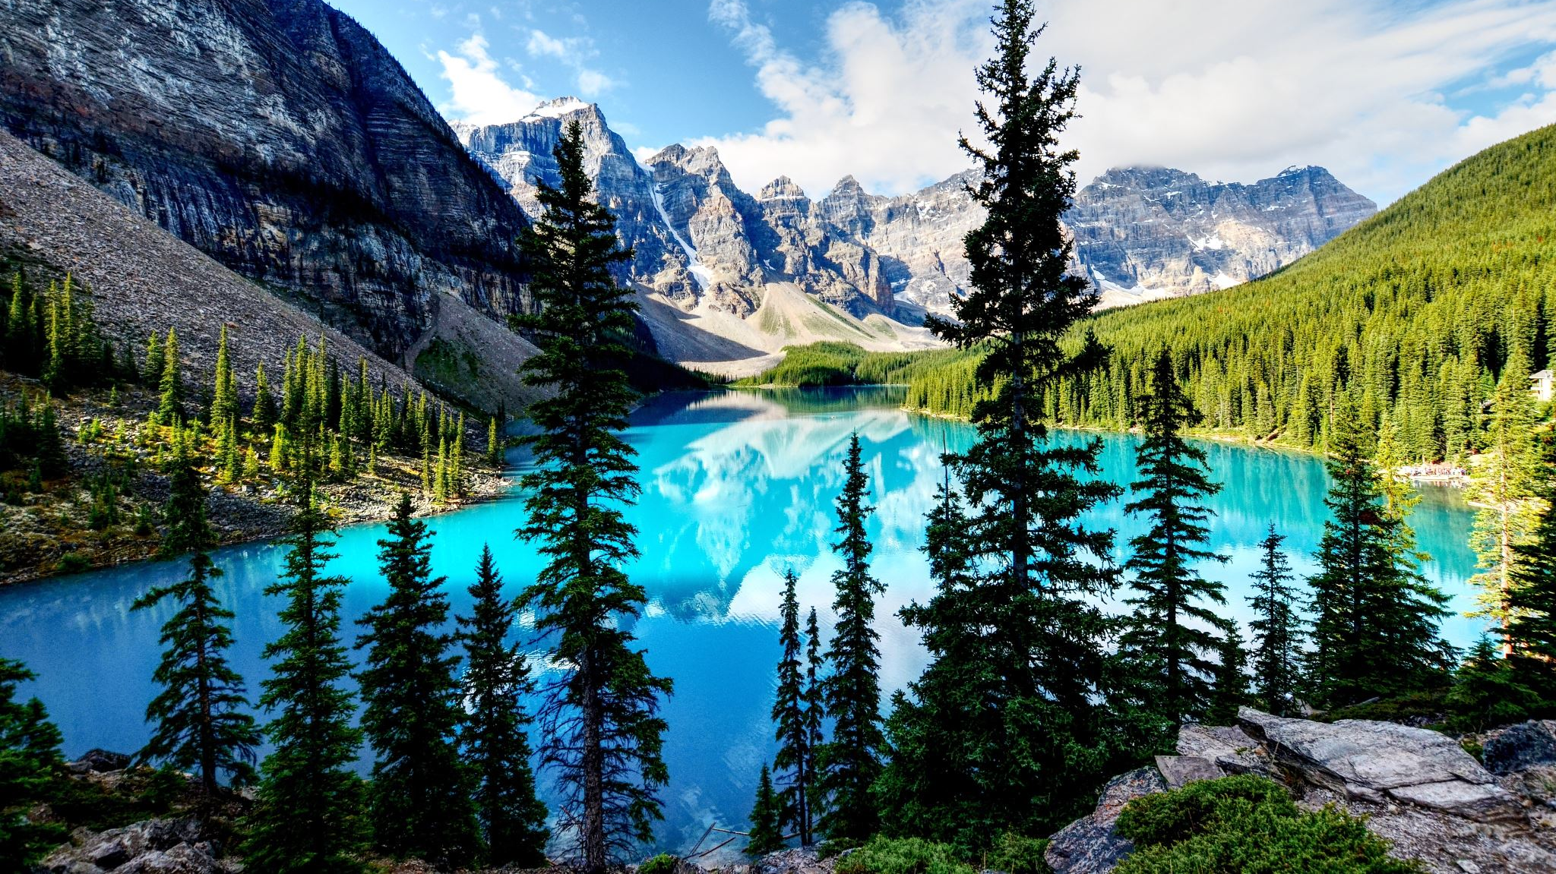
Database ERD System
Presidential election
Group 5 :
Farel
Deni
Petra
Daniel
Wilbert
David

Slide 2
Entities
Party
Voters
Candidate
Election Place
Committee
Security

Slide 3
3NF

Slide 4
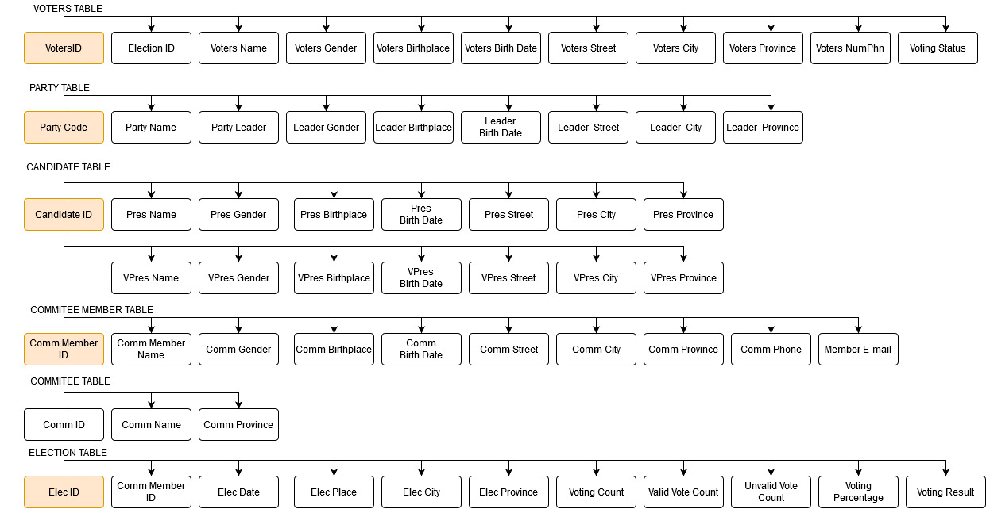
3NF Table

Slide 5
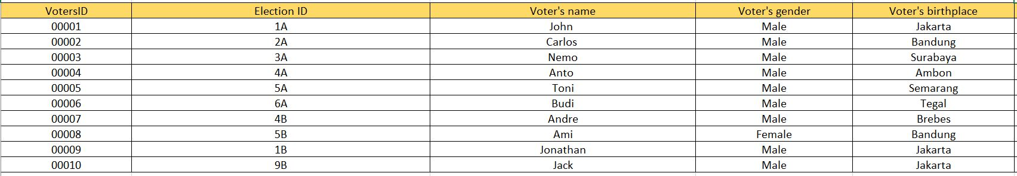
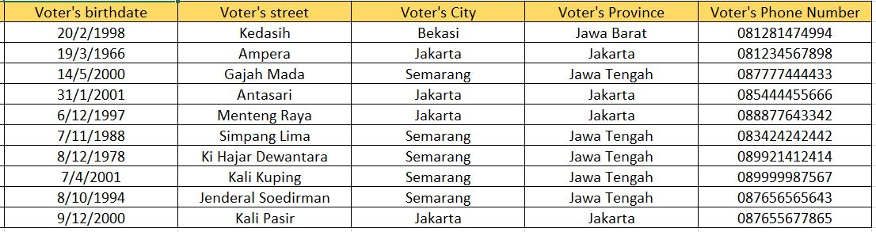
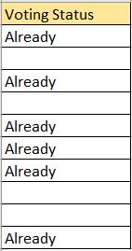
3NF
Table Name: Voters

Slide 6
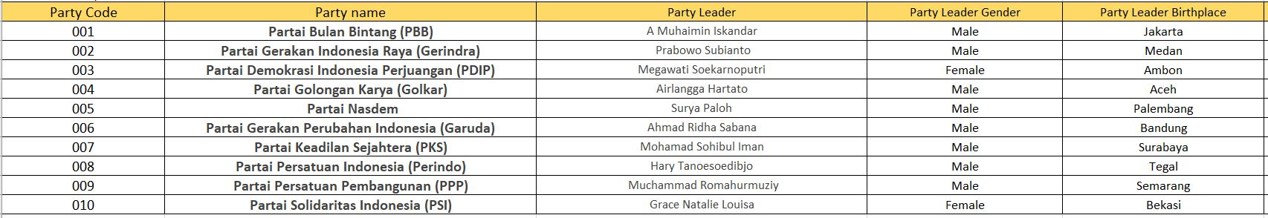
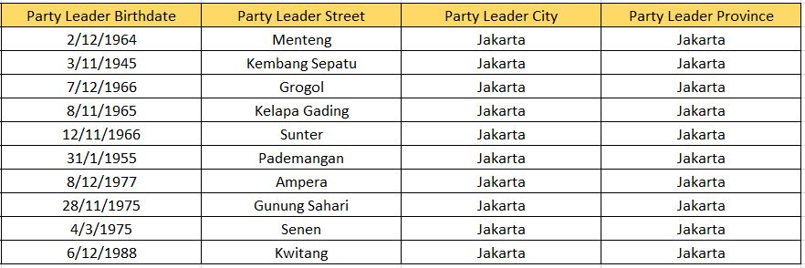
3NF
Table Name: Party

Slide 7
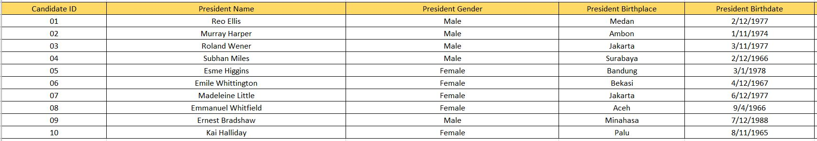
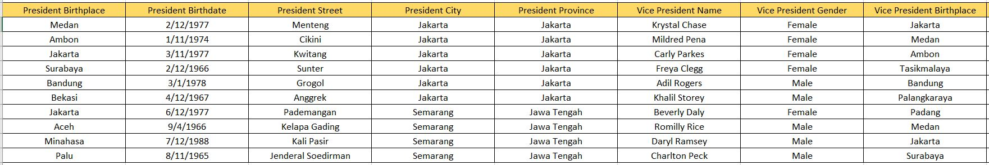
3NF
Table Name: Candidate

Slide 8
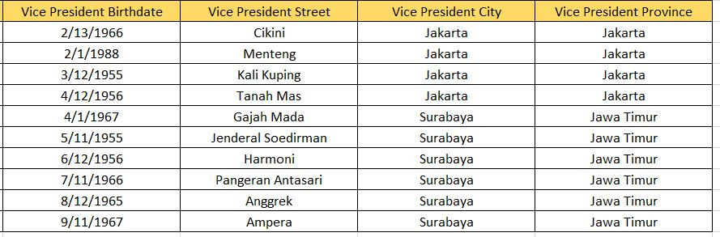
3NF

Slide 9
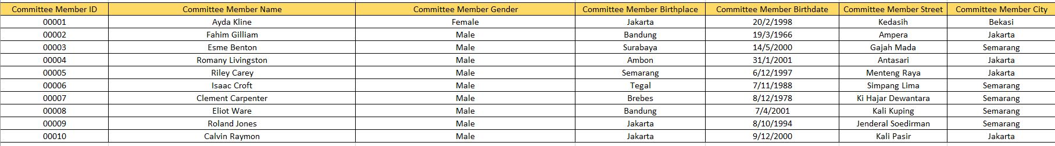
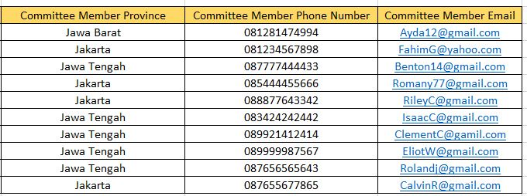
3NF
Table Name: Committee Member

Slide 10
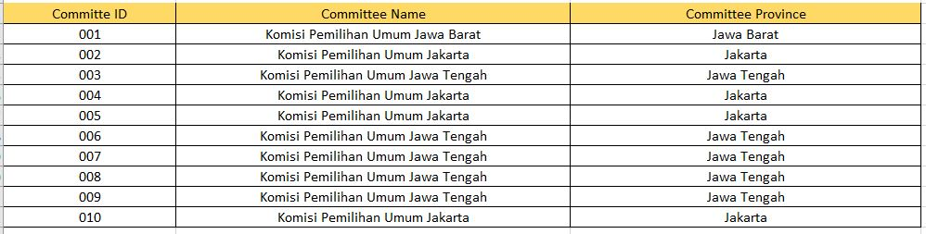
3NF
Table Name: Committee

Slide 11
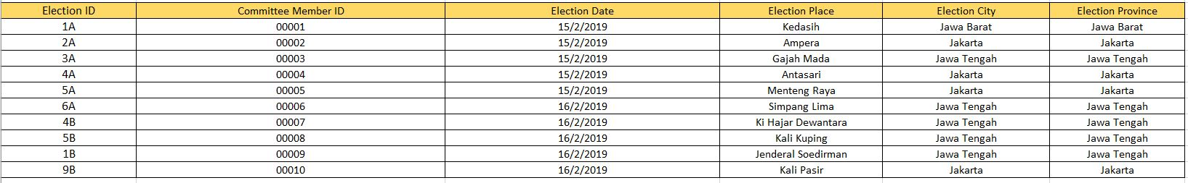
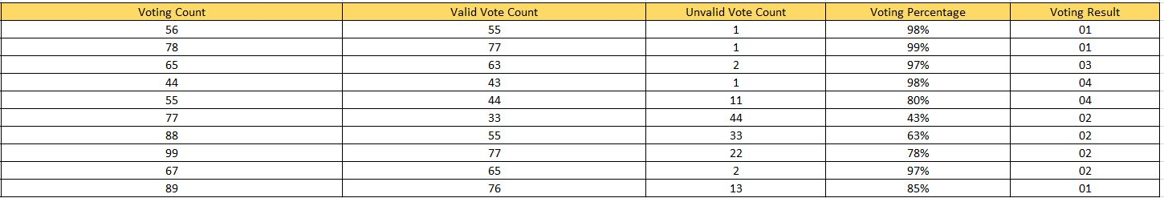
3NF
Table Name: Election Place

Slide 12
SQL Server management
Studio
tables

Slide 13
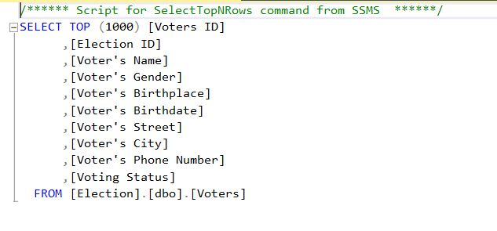
SQL Server management Studio tables
Table Name: Voters

Slide 14
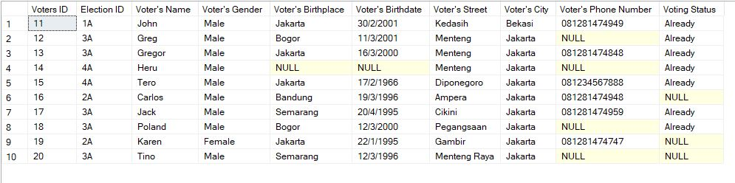
SQL Server management Studio tables
Table Name: Voters

Slide 15
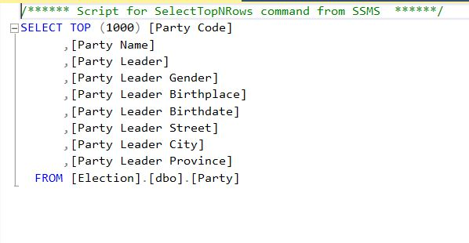
SQL Server management Studio tables
Table Name: Party

Slide 16
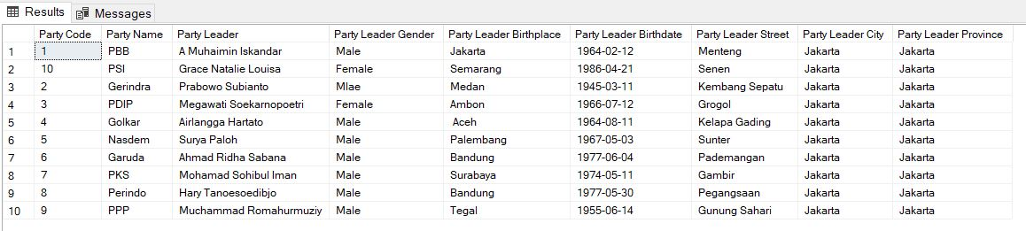
SQL Server management Studio tables
Table Name: Party

Slide 17
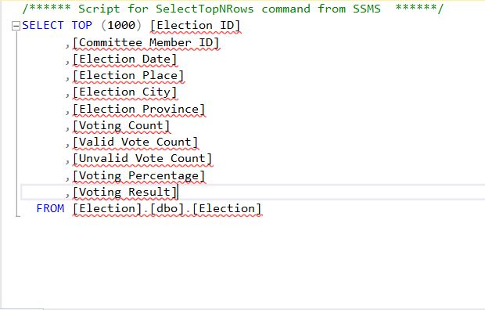
SQL Server management Studio tables
Table Name: Election

Slide 18
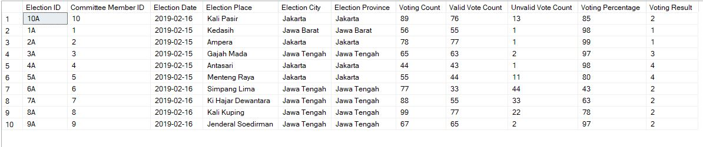
SQL Server management Studio tables
Table Name: Election

Slide 19
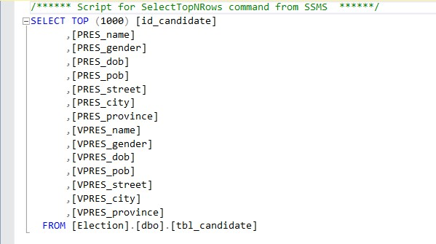
SQL Server management Studio tables
Table Name: Candidate

Slide 20
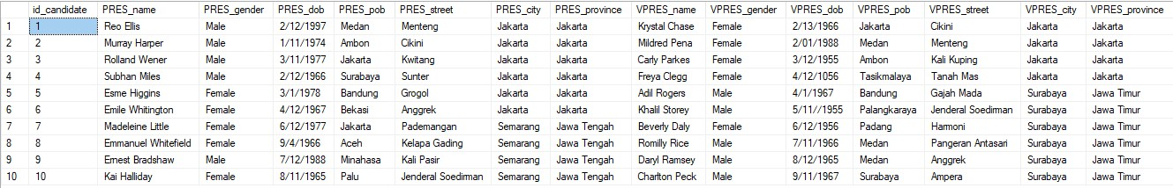
SQL Server management Studio tables
Table Name: Candidate

Slide 21
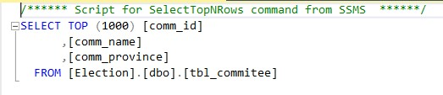
SQL Server management Studio tables
Table Name: Commitee

Slide 22
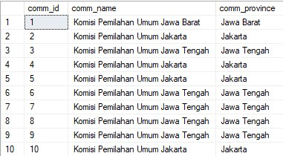
SQL Server management Studio tables
Table Name: Commitee

Slide 23
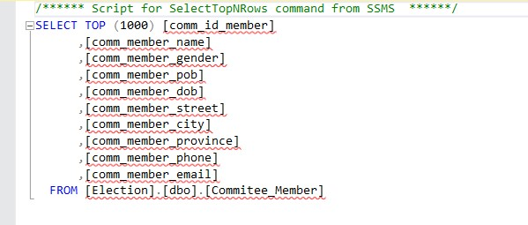
SQL Server management Studio tables
Table Name: Committee Member

Slide 24
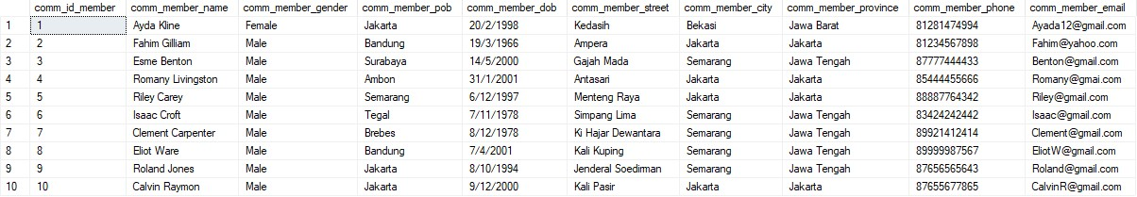
SQL Server management Studio tables
Table Name: Committee Member

Slide 25
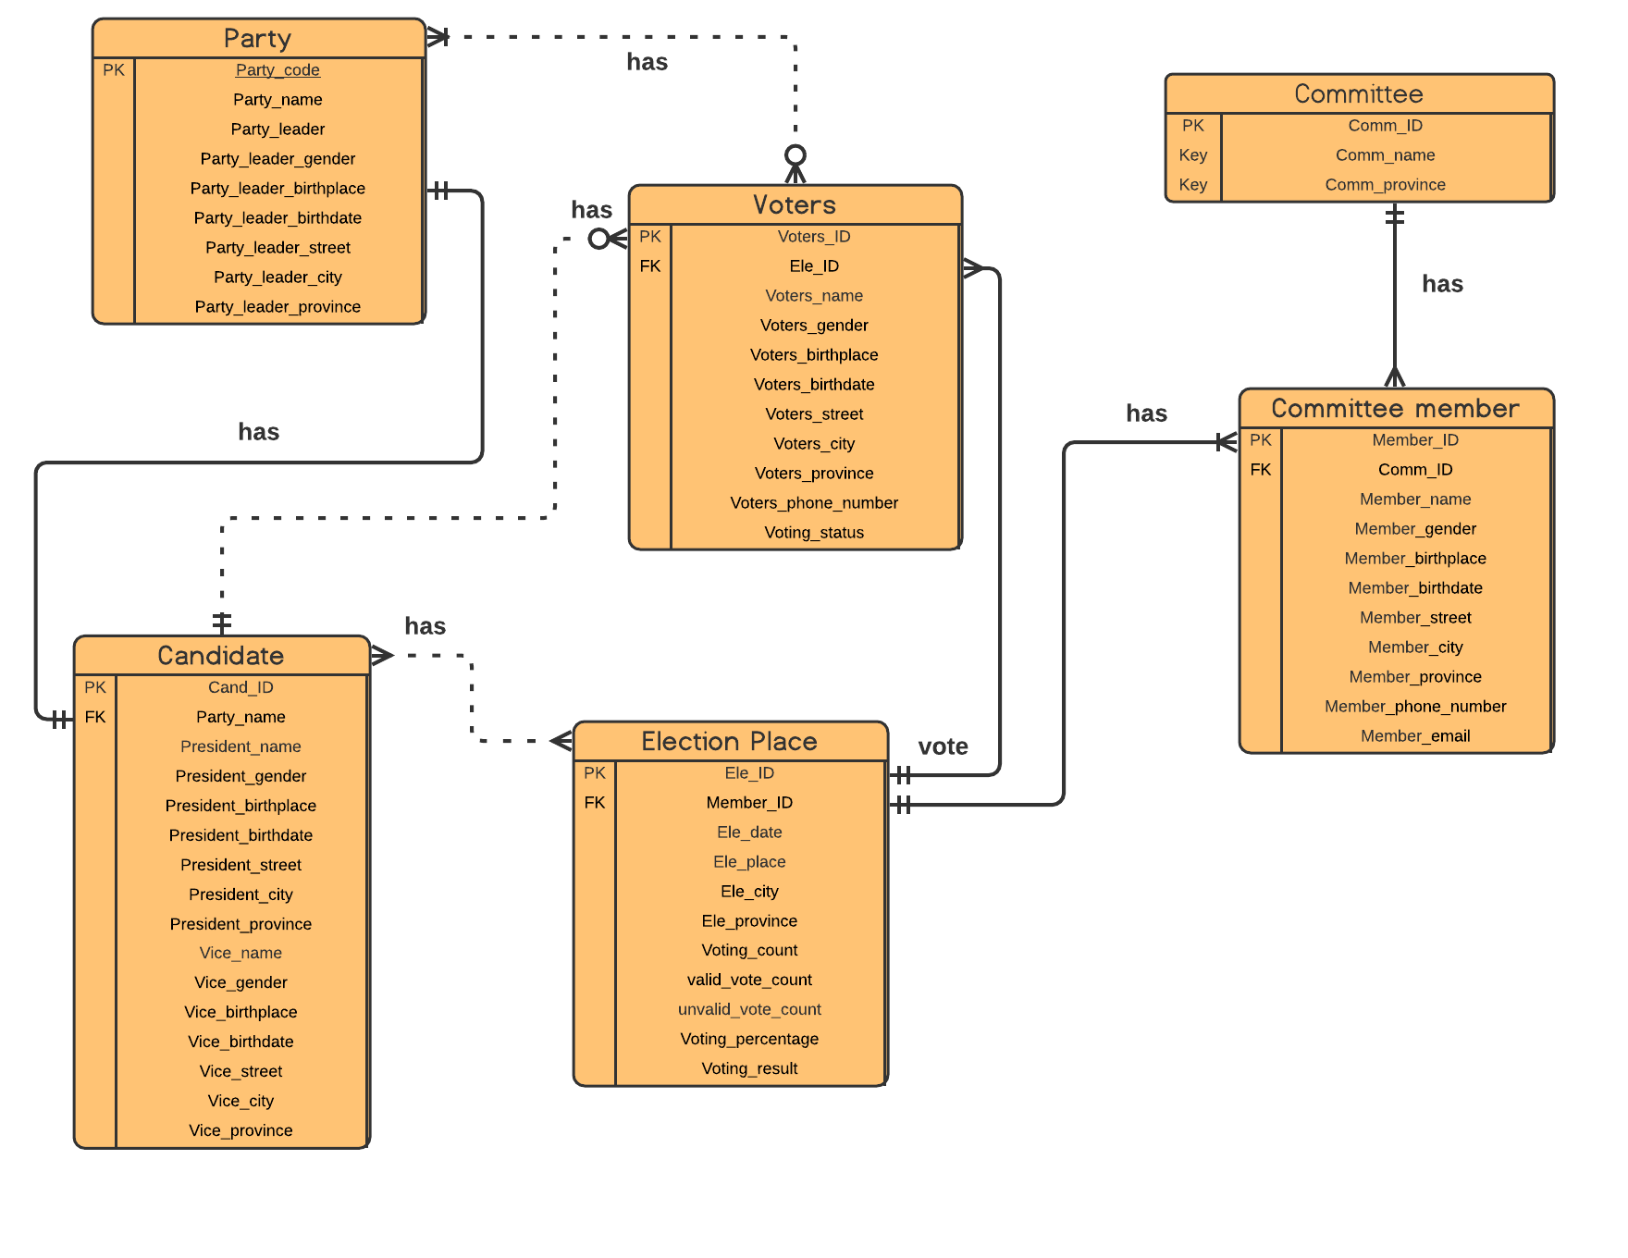
2NF

Slide 26
THANK YOU

